Slide 1
Welcome to first grade!
Mr. Hassey
G1B Homeroom Teacher

Slide 2
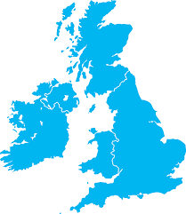
Introduction
I am from Sydney, Australia but have spent most of my life in Asia. I have a Bachelor of Creative arts and a Masters of Teaching. I started teaching in 2009.

Slide 3
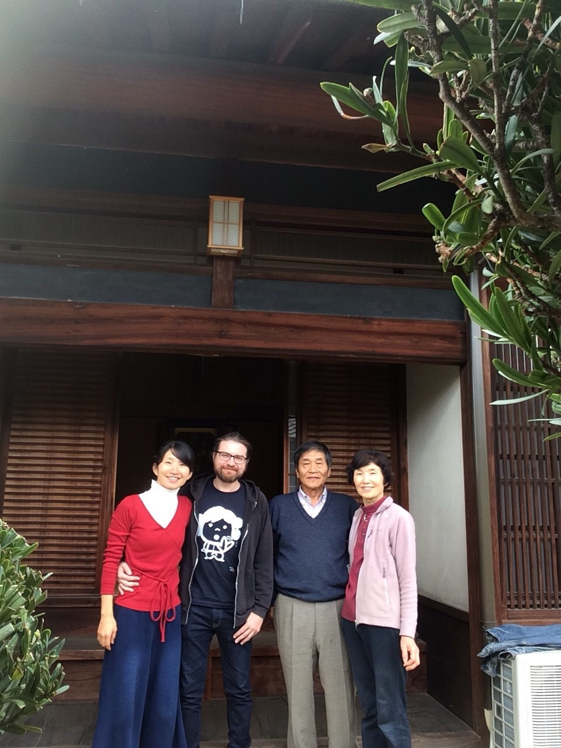
I moved to Tokyo with my wife in June.
We are both getting used to living in the city as we both used to live on farms (in Izumi and Australia.)
Keiko
Shige-Chan
You-Chan

Slide 4
School Information - Arrival / Dismissal
Arrival
8:15 AM - Doors open
8:25 AM - G1 students must be at school or they will be marked TARDY for attendance
8:30 AM - Homeroom begins
Dismissal
3:20 PM - G1 dismissal
If your child has an older sibling, he/she will be dismissed at 3:25 PM.
If you need to speak with me during dismissal, please send me an email or we can select a day/time to set up a meeting.

Slide 5
School Information - Uniforms
G1B - P.E. Days
Wednesday, Friday
G1B - Swimming
Thursday
What is the correct P.E. uniform?
Orange or Green school t-shirt; navy sweatpants or shorts, and navy zipper sweatshirt (from Uniqlo or equivalent); running shoes.
PE uniforms are to be worn on PE days ONLY. If your children have an athletic club after school, please give them change of clothes to bring to school.
What is the correct regular uniform?
Girls: skorts/navy trousers or dresses, short or long-sleeve red or navy shirt with school logo and navy cardigan with school logo during cold season. Girls also should be wearing navy long socks or navy tights.
Boys: navy school shorts or pants (no other styles or colors are allowed). Short or long-sleeve red or navy shirts with school logo and navy cardigan with school logo during cold season.
What is the correct attire for field trips?
PE uniform with ORANGE school T-shirt.

Slide 6
School Information - Uniforms
What is NOT the correct dress code?
Wearing long sleeve T-shirts underneath the school’s short-sleeve shirts. Students should wear either the school’s long-sleeve logo shirt or school cardigan/fleece.
Wearing leggings of any color.
Wearing cardigans or jackets that are not school jackets (overcoats excluded).
Coming to school in dirty or ripped uniform.
Makeup or jewelry is not allowed.

Slide 7
Classroom Rules
3 Rs - Respectful, Responsible, Ready
Sitting (Cross-legged)
Class Dojo - positive choices (parents sign up) + prize box.
Mr Hassey’s Expectations
Negative people.
Restorative Justice - Problem Solving/Think Sheets *Instead of punishment for a broken rule, students will practice examining the problem/harm caused by their actions and finding the best way to make amends for that problem/harm

Slide 9
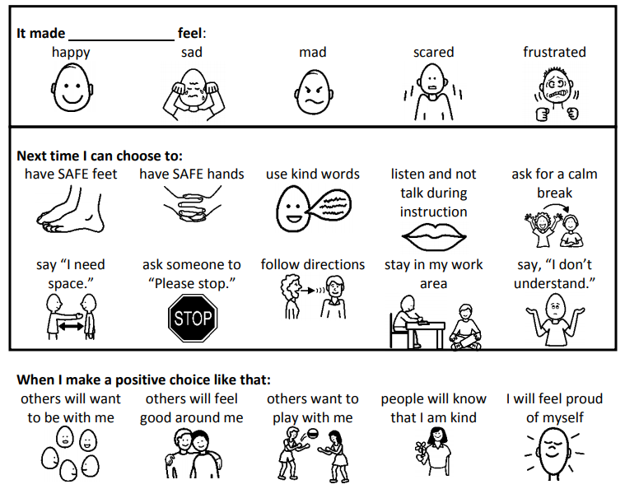

Slide 10
Is my child ready for school?
Please label all items with your child’s name!
Everyday Folder (homework), towel, water bottle, snack, lunch Japanese Class - folder and homework
Swimming - Thursday Swim bag, swimming cap, towel, goggles, zip lock bag (wet clothes), uniform clothes, extra underwear
P.E. - Monday/FridayStudents wear P.E. uniform to school on these days

Slide 11
Homework
Homework Weekly Schedule *Keep homework schedule in your child’s folder all year Bring folder to school every day
Spelling (handwriting) *Weekly words to practice reading and spelling *Spelling notebook
Red Folder: Reading *Reading books and reading log *Raz-Kids (weekend) Blue Folder: Word Work Math

Slide 12
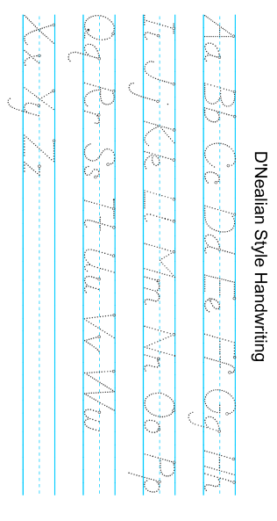
Kk

Slide 16
Homework - Raz Kids
*The website is changing. We may start Raz-Kids late.
Kids A-Z Login Instructions
Step 1: Go to www.kidsa-z.com Step 2: Enter or choose the teacher's username, ustreading1 Step 3: Your child finds his or her username on the class chart Step 4: Your child enters his or her password, 123
Login cards and directions will be sent home.

Slide 17
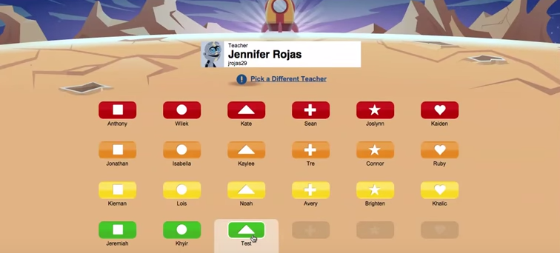
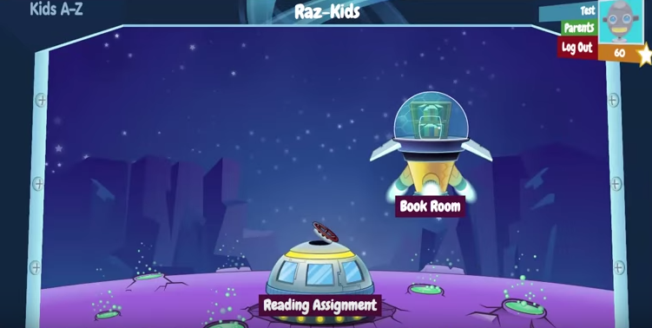
Click on your child’s name.
Click on Reading Assignments. These books will be at your child’s level.

Slide 18
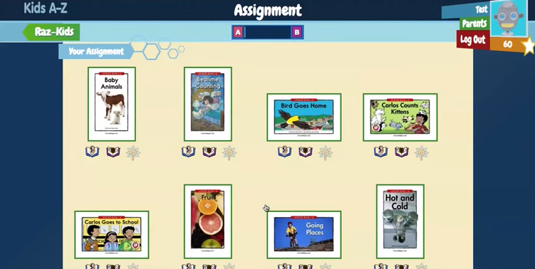
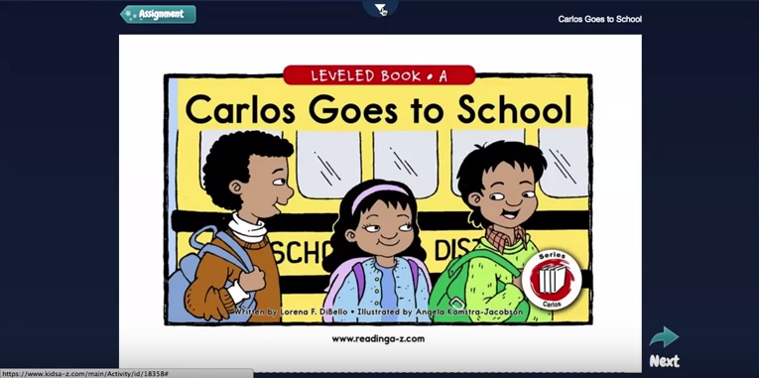
Select a book your child wants to read.
Ear - book is read to your child
Eye - record your child reading out loud
*Tablet, iphone, computer, laptop
Click on the arrow at the top. Click on the red microphone. Click on the record button.

Slide 19
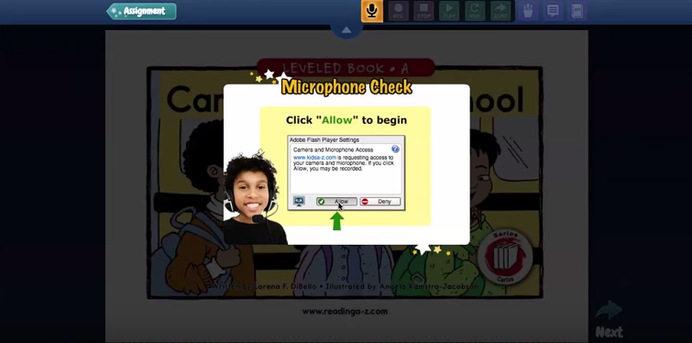
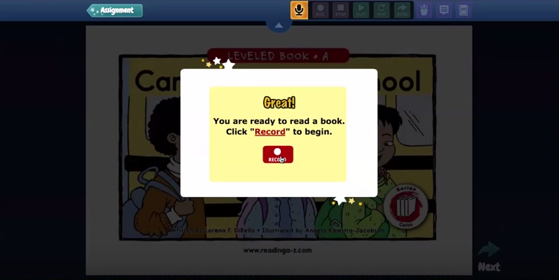
Step 1: Say your name Step 2: Listen to your name (what you recorded) Step 3: Did you hear your name? Yes / No Yes - Ready to record!
Press record and read the book. DO NOT CLICK DONE!
Click STOP at the top.
Play - Listen to what you recorded New - Rerecord / New recording Send - Send to teacher You can press play after sending it to listen to the recording. Great opportunity to help your student with their reading and ask WHY questions to check comprehesion.

Slide 20
Extra Details About our Classroom
* Coach Adam’s words/Word wall.
* Classroom jobs - Will be student led + chosen.
* Brain Breaks - GoNoodle, ‘Mr Kodama’ exercise
* Student portfolios (wall display)
* ESL/Learning support (miss Japanese class)

Slide 21
Birthday Celebrations
* Student brings a book from home or picks a book in the classroom to read to the class
* Every month we’ll have a day to celebrate all Grade 1 birthdays in that month (birthday cards, snacks)
- Date will be selected for the end of the month and emailed to parents
* HOME Birthday Parties - Please invite all students if invitations are sent to school

Slide 22
Parent Involvement - Expectations
* Homework completion Weekly Reading/Raz-Kids: Why questions (comprehension)
* Email (parent/teacher communication) If dismissal changes, please send me an email.
* Class Dojo (positive behavior)
* Weebly (parent/teacher communication)
http://united-school-tokyo.weebly.com

Slide 23
Parent Involvement - Volunteer
* PTA
PTA Contact: ustptajapan@gmail.com
* Field Trips (each field trip needs 1 chaperone per class)
* Monthly Mystery Reader (volunteer)

Slide 24
UST Beginning of Year Forms
*Child Pick Up Permission
*Waiver Form
*Confirmation of Understanding Form
G1B - Student Information Form
Class Dojo (sign up)

Slide 25
Questions?

