Slide 1
Our Eco-Footprint
By: The Grade 3 Class

Slide 2
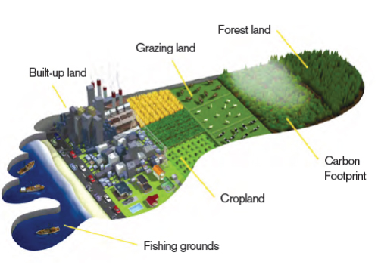
What is an Eco-Footprint?
An ecological footprint is a measure of how much humans impact the Earth’s ecosystem.
It is measured by AREA of wilderness or amount of space.

Slide 3
What Categories Are Measured?

Slide 4
Pop Quiz:
What is the biggest contributors to Carbon Dioxide? A) Land Use (Farming)
B) Industrial Processes (Manufacturing)
C) Fossil Fuels
What form of transportation releases the most CO2?
A) Automobiles
B) Planes
C) Industrial Ships

Slide 5
Facts:
Many countries have different eco foot prints. Here are how many earths are required if everyone consumed at the rate of these countries.
Country | Footprint Per Person | How Many Earths?
Canada | 6.6 hectares | 3.8
United States of America | 6.8 hectares | 3.9
Australia | 8.3 hectares | 4.8
Japan | 4.7 hectares | 2.4

Slide 6
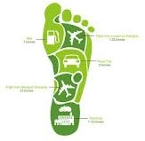
Measuring our Eco Footprints
After answering various questions, our class discovered how Eco Friendly we were.

Slide 7
Measuring our Eco Footprints
On average our class requires 2.75 planets

Slide 10
How to Reduce our Eco Footprint?
Electricity Make sure all electronic devices are turned off when not in use, including lights and air conditioners
Transportation Actively look for alternative methods to travel such as cycling, walking, or public transit
Waste Make an effort to use less plastics and use more reusable items

Slide 11
Take The Test!
We invite you to take your own Eco-Foot print challenge and see how environmentally friendly you are. Visit this website on the Grade 3 Weebly http://ecocamp.us/eco-footprint-calculator GOOD LUCK!

